Slide 1
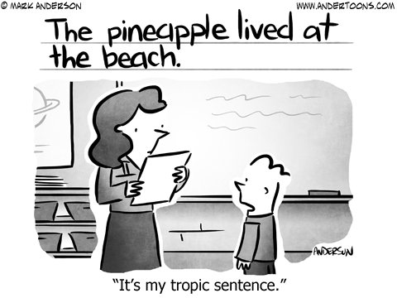
Writing: Before You Write…

Slide 2
CONSTRUCTED RESPONSE OR SHORT ANSWER
They both ask you to apply your knowledge and understanding in a short written answer.
Difference between a constructed response and short answer:
A constructed response will always have a document to analyze with the question.
A short answer may or may not have a document to analyze with the question so they are very similar.

Slide 3
BEFORE YOU WRITE…
PLANNING:
Read the entire question.
Identify and underline key words in the question, such as: explain, elaborate, illustrate.
Restate the prompt in your own words to be sure that you understand it.
List items you should identify in your answer
List facts & examples to support your answer

Slide 4
HOW DO I ANSWER A CONSTRUCTRED RESPONSE???
RACE to YOUR ANSWER!

Slide 5
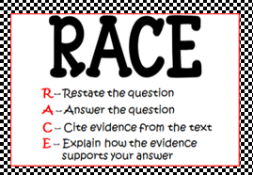

Slide 6
R – RESTATE THE QUESTION
Look for key words in the question like:
EXPLAIN DESCRIBE
COMPARE CONTRAST
DISCUSS ANALYZE
Reword question and make it into a statement as a part of the answer you provide.
Include title and author of work being discussed
Simple Example:
SCR - "What color is the sky?“
Reword- “The color of the sky is…”

Slide 7
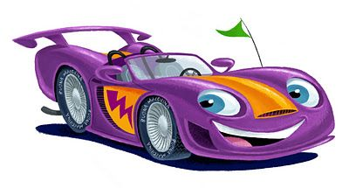
A– ANSWER THE QUESTION
ANSWER THE QUESTION using evidence from the text you just read.
Usually R & A in R.A.C.E. are written within the same sentence.
Example:
SCR QUESTION: “What color is the sky?”
REWORD: The color of the sky is …
ANSWER: usually blue because of how we see light waves and the weather conditions.

Slide 8
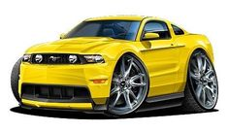
C– CITE EVIDENCE
Use words, facts, or examples from the text to support
the R & A in R.A.C.E
At least 2 Evidence or Examples
EXAMPLE:
The sky is usually blue because of how we see light waves and the weather conditions. According to scientist, humans see blue sky based on what “kinds of light waves are visualized” in the eye, how sunny the day is and the direction of the sunlight.
**the underlined phrases are cited evidence from the text

Slide 9
E– EXPLAIN YOUR REASON
EXPLAIN THE ANSWER: Explain how the RAC part of your response correctly answers the question; E can be based on prior knowledge of the topic or more evidence from the text
EXAMPLE:
The sky is usually blue because of how we see light waves and the weather conditions. According to scientist, humans see blue sky based on what “kinds of light waves are visualized” in the eye, how sunny the day is and the direction of the sunlight. On a clear, sunny day, the sun is directly shining on us. Because the molecules in the air reflect the scattered blue light waves more than red or orange when it bounces off the direct sunlight, we see blue. As the sun sets, the direction of its light goes away from us so the molecules reflect the red or orange waves of light that we see at sunsets.

Slide 10
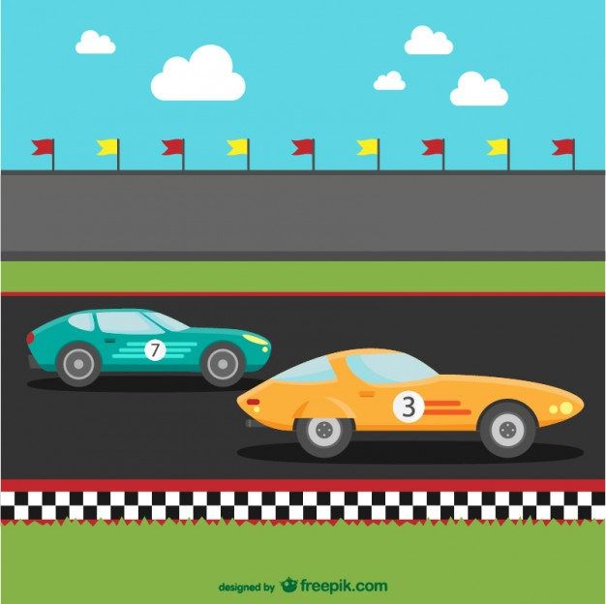
NOW YOU TRY…
You will read a passage about George Washington Carver and then write a response to the following prompt:
Explain how George Washington Carver’s
ideas affect our lives today.
You may want to use the following R.A.C.E. organizer to help you plan your response.
Remember to RACE to your answer…
Restate (reword)
Answer
Cite
Explain

Slide 12
HERE IS HOW TO DO IT…
R – REWORD THE QUESTION | A – ANSWER THE QUESTION
C – CITE EVIDENCE YOU WILL USE | E – EXPLAIN YOUR REASONING

